Slide 1
Chapter 3
Arithmetic for Computers
Notes:
Morgan Kaufmann Publishers
Chapter 3 — Arithmetic for Computers

Slide 2
Arithmetic for Computers
Operations on integers
  Addition and subtraction
  Multiplication and division
  Dealing with overflow
Floating-point real numbers
  Representation and operations
Chapter 3 — Arithmetic for Computers — <number>
Notes:
Morgan Kaufmann Publishers
Chapter 3 — Arithmetic for Computers

Slide 3

Integer Addition
Example: 7 + 6
Overflow if result out of range
  Adding +ve and –ve operands, no overflow
  Adding two +ve operands
    Overflow if result sign is 1
  Adding two –ve operands
    Overflow if result sign is 0
Chapter 3 — Arithmetic for Computers — <number>
Notes:
Morgan Kaufmann Publishers
Chapter 3 — Arithmetic for Computers

Slide 4
Integer Subtraction
Add negation of second operand
Example: 7 – 6 = 7 + (–6)
  +7: 0000 0000 … 0000 0111
  –6: 1111 1111 … 1111 1010
  +1: 0000 0000 … 0000 0001
Overflow if result out of range
  Subtracting two +ve or two –ve operands, no overflow
  Subtracting +ve from –ve operand
    Overflow if result sign is 0
  Subtracting –ve from +ve operand
    Overflow if result sign is 1
Chapter 3 — Arithmetic for Computers — <number>
Notes:
Morgan Kaufmann Publishers
Chapter 3 — Arithmetic for Computers

Slide 5
Dealing with Overflow
Some languages (e.g., C) ignore overflow
  Use MIPS addu, addui, subu instructions
Other languages (e.g., Ada, Fortran) require raising an exception
  Use MIPS add, addi, sub instructions
  On overflow, invoke exception handler
    Save PC in exception program counter (EPC) register
    Jump to predefined handler address
    mfc0 (move from coprocessor reg) instruction can retrieve EPC value, to return after corrective action
Chapter 3 — Arithmetic for Computers — <number>
Notes:
Morgan Kaufmann Publishers
Chapter 3 — Arithmetic for Computers

Slide 6
Arithmetic for Multimedia
Graphics and media processing operates on vectors of 8-bit and 16-bit data
  Use 64-bit adder, with partitioned carry chain
    Operate on 8×8-bit, 4×16-bit, or 2×32-bit vectors
  SIMD (single-instruction, multiple-data)
Saturating operations
  On overflow, result is largest representable value, i.e., the largest positive no. or the most negative no. when overflow occurs.
  Saturation operation for media operations
    E.x. a volume knob
Chapter 3 — Arithmetic for Computers — <number>
Notes:
Morgan Kaufmann Publishers
Chapter 3 — Arithmetic for Computers

Slide 7

Multiplication
Start with long-multiplication approach
multiplicand
1000
× 1001
1000
0000
0000
1000
1001000
multiplier
product
Length of product is the sum of operand lengths
Chapter 3 — Arithmetic for Computers — <number>
Notes:
Morgan Kaufmann Publishers
Chapter 3 — Arithmetic for Computers

Slide 8

Multiplication Hardware
Initially 0
Chapter 3 — Arithmetic for Computers — <number>
Notes:
Morgan Kaufmann Publishers
Chapter 3 — Arithmetic for Computers

Slide 9
Chapter 3 — Arithmetic for Computers — <number>

Slide 10
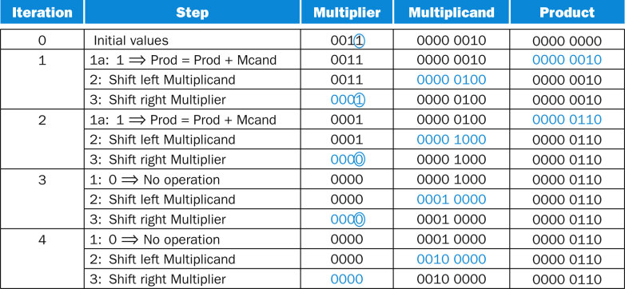
FIGURE 3.6 Multiply example using algorithm in Figure 3.4. The bit examined to determine the next step is circled in color.
Chapter 3 — Arithmetic for Computers — <number>

Slide 11

Optimized Multiplier
Perform steps in parallel: add/shift
Multiplier is initially placed here
Shift product right 1 bit is equivalent to shift left 1 bit of multiplicand
One cycle per partial-product addition
  That’s ok, if frequency of multiplications is low
Chapter 3 — Arithmetic for Computers — <number>
Notes:
Morgan Kaufmann Publishers
Chapter 3 — Arithmetic for Computers

Slide 12
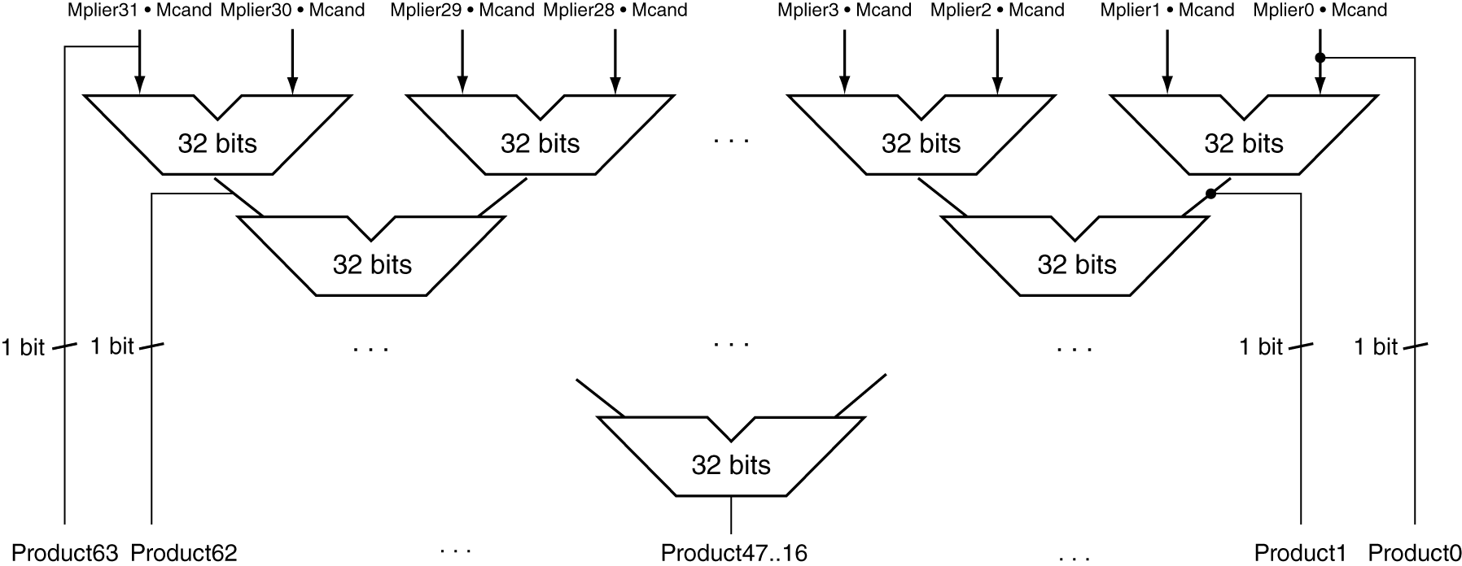
Faster Multiplier
Uses multiple adders
  Cost/performance tradeoff
Can be pipelined
  Several multiplication performed in parallel
Chapter 3 — Arithmetic for Computers — <number>
Notes:
Morgan Kaufmann Publishers
Chapter 3 — Arithmetic for Computers

Slide 13
MIPS Multiplication
Two 32-bit registers for product
  HI: most-significant 32 bits
  LO: least-significant 32-bits
Instructions
  mult rs, rt / multu rs, rt
    64-bit product in HI/LO
  mfhi rd / mflo rd
    Move from HI/LO to rd
    Can test HI value to see if product overflows 32 bits
  mul rd, rs, rt
    Least-significant 32 bits of product –> rd
Chapter 3 — Arithmetic for Computers — <number>
Notes:
Morgan Kaufmann Publishers
Chapter 3 — Arithmetic for Computers

Slide 14
Division
§3.4 Division
Check for 0 divisor
Long division approach
  If divisor ≤ dividend bits
    1 bit in quotient, subtract
  Otherwise
    0 bit in quotient, bring down next dividend bit
Restoring division
  Do the subtract, and if remainder goes < 0, add divisor back
Signed division
  Divide using absolute values
  Adjust sign of quotient and remainder as required
quotient
dividend
1001
1000 1001010
-1000
10
101
1010
-1000
10
divisor
remainder
n-bit operands yield n-bit
quotient and remainder
Chapter 3 — Arithmetic for Computers — <number>
Notes:
Morgan Kaufmann Publishers
Chapter 3 — Arithmetic for Computers

Slide 15


Division Hardware
Initially divisor in left half
Initially dividend
32 bits
33 iterations
Chapter 3 — Arithmetic for Computers — <number>
Notes:
Morgan Kaufmann Publishers
Chapter 3 — Arithmetic for Computers

Slide 16
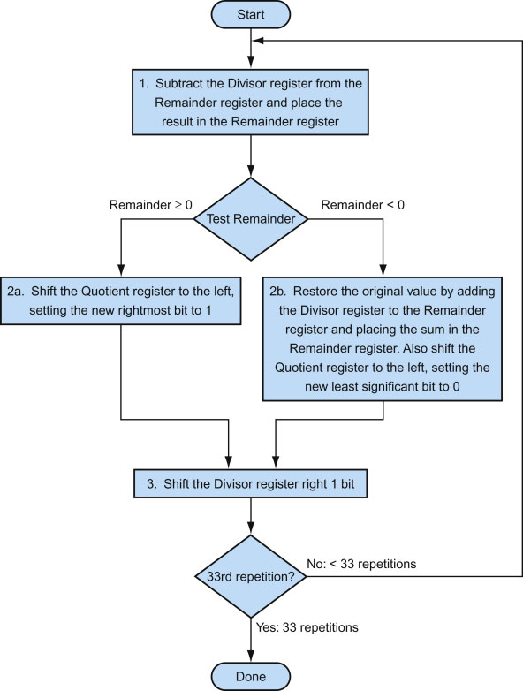
Chapter 3 — Arithmetic for Computers — <number>

Slide 17
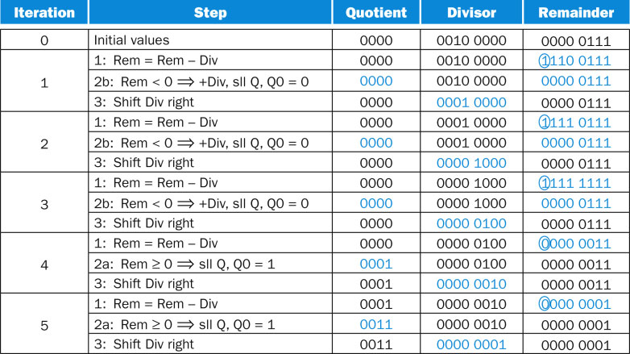
FIGURE 3.10 Division example using the algorithm in Figure 3.9. The bit examined to determine the next step is circled in color.
Chapter 3 — Arithmetic for Computers — <number>

Slide 18

Optimized Divider
Dividend initially
Remainder, Quotient
One cycle per partial-remainder subtraction
Looks a lot like a multiplier!
  Same hardware can be used for both
Chapter 3 — Arithmetic for Computers — <number>
Notes:
Morgan Kaufmann Publishers
Chapter 3 — Arithmetic for Computers

Slide 19
Faster Division
Can’t use parallel hardware as in multiplier
  Subtraction is conditional on sign of remainder
Faster dividers (e.g. SRT devision) generate multiple quotient bits per step
  Still require multiple steps
Chapter 3 — Arithmetic for Computers — <number>
Notes:
Morgan Kaufmann Publishers
Chapter 3 — Arithmetic for Computers

Slide 20
MIPS Division
Use HI/LO registers for result
  HI: 32-bit remainder
  LO: 32-bit quotient
Instructions
  div rs, rt / divu rs, rt
  No overflow or divide-by-0 checking
    Software must perform checks if required
  Use mfhi, mflo to access result
Chapter 3 — Arithmetic for Computers — <number>
Notes:
Morgan Kaufmann Publishers
Chapter 3 — Arithmetic for Computers

Slide 21
Floating Point
Representation for non-integral numbers
  Including very small and very large numbers
Like scientific notation
  –2.34 × 10⁵⁶
  +0.002 × 10^{–4}
  +987.02 × 10⁹
In binary
  ±1.xxxxxxx₂ × 2^{yyyy}
Types float and double in C
normalized
not normalized
Chapter 3 — Arithmetic for Computers — <number>
Notes:
Morgan Kaufmann Publishers
Chapter 3 — Arithmetic for Computers

Slide 22
Floating Point Standard
Defined by IEEE Std 754-1985
Developed in response to divergence of representations
  Portability issues for scientific code
Now almost universally adopted
Two representations
  Single precision (32-bit)
  Double precision (64-bit)
Chapter 3 — Arithmetic for Computers — <number>
Notes:
Morgan Kaufmann Publishers
Chapter 3 — Arithmetic for Computers

Slide 23
IEEE Floating-Point Format
single: 8 bits
double: 11 bits
single: 23 bits
double: 52 bits
S
Exponent
Fraction
View + as a binary point .
S: sign bit (0 ⇒ non-negative, 1 ⇒ negative)
Normalize significand: 1.0 ≤ |significand| < 2.0
  Always has a leading pre-binary-point 1 bit, so no need to represent it explicitly (hidden bit)
  Significand is Fraction with the “1.” restored
Exponent: excess representation: actual exponent + Bias
  Ensures exponent is unsigned
  Single: Bias = 127; Double: Bias = 1203
Chapter 3 — Arithmetic for Computers — <number>
Notes:
Morgan Kaufmann Publishers
Chapter 3 — Arithmetic for Computers

Slide 24
Single-Precision Range
Exponents 00000000 and 11111111 reserved
Smallest value
  Exponent: 00000001
  ⇒ actual exponent = 1 – 127 = –126
  Fraction: 000…00 ⇒ significand = 1.0
  ±1.0 × 2^{–126} ≈ ±1.2 × 10^{–38}
Largest value
  exponent: 11111110
  ⇒ actual exponent = 254 – 127 = +127
  Fraction: 111…11 ⇒ significand ≈ 2.0
  ±2.0 × 2⁺¹²⁷ ≈ ±3.4 × 10⁺³⁸
Chapter 3 — Arithmetic for Computers — <number>
Notes:
Morgan Kaufmann Publishers
Chapter 3 — Arithmetic for Computers

Slide 25
Double-Precision Range
Exponents 0000…00 and 1111…11 reserved
Smallest value
  Exponent: 00000000001
  ⇒ actual exponent = 1 – 1023 = –1022
  Fraction: 000…00 ⇒ significand = 1.0
  ±1.0 × 2^{–1022} ≈ ±2.2 × 10^{–308}
Largest value
  Exponent: 11111111110
  ⇒ actual exponent = 2046 – 1023 = +1023
  Fraction: 111…11 ⇒ significand ≈ 2.0
  ±2.0 × 2⁺¹⁰²³ ≈ ±1.8 × 10⁺³⁰⁸
Chapter 3 — Arithmetic for Computers — <number>
Notes:
Morgan Kaufmann Publishers
Chapter 3 — Arithmetic for Computers

Slide 26
Floating-Point Precision
Relative precision
  all fraction bits are significant
  Single: approx 2^{–23}
    Equivalent to 23 × log₁₀2 ≈ 23 × 0.3 ≈ 6 decimal digits of precision
  Double: approx 2^{–52}
    Equivalent to 52 × log₁₀2 ≈ 52 × 0.3 ≈ 16 decimal digits of precision
Chapter 3 — Arithmetic for Computers — <number>
Notes:
Morgan Kaufmann Publishers
Chapter 3 — Arithmetic for Computers

Slide 27
Floating-Point Example
Represent –0.75
  –0.75 = (–1)¹ × 1.1₂ × 2^{–1}
  S = 1
  Fraction = 1000…00₂
  Exponent = –1 + Bias
    Single: –1 + 127 = 126 = 01111110₂
    Double: –1 + 1023 = 1022 = 01111111110₂
Single: 1 01111110 1000…00
Double: 1 01111111110 1000…00
Chapter 3 — Arithmetic for Computers — <number>
Notes:
Morgan Kaufmann Publishers
Chapter 3 — Arithmetic for Computers

Slide 28
Floating-Point Example
What number is represented by the single-precision float
1 10000001 01000…00
  S = 1
  Fraction = 01000…00₂
  Fxponent = 10000001₂ = 129
x = (–1)¹ × (1 + 01₂) × 2^{(129 – 127)}
  = (–1) × 1.25 × 2²
  = –5.0
Chapter 3 — Arithmetic for Computers — <number>
Notes:
Morgan Kaufmann Publishers
Chapter 3 — Arithmetic for Computers

Slide 29
Floating-Point Addition
Consider a 4-digit decimal example
  9.999 × 10¹ + 1.610 × 10^{–1}
1. Align decimal points
  Shift number with smaller exponent
  9.999 × 10¹ + 0.016 × 10¹
2. Add significands
  9.999 × 10¹ + 0.016 × 10¹ = 10.015 × 10¹
3. Normalize result & check for over/underflow
  1.0015 × 10²
4. Round and renormalize if necessary
  1.002 × 10²
Chapter 3 — Arithmetic for Computers — <number>
Notes:
Morgan Kaufmann Publishers
Chapter 3 — Arithmetic for Computers

Slide 30
Floating-Point Addition
Now consider a 4-digit binary example
  1.000₂ × 2^{–1} + –1.110₂ × 2^{–2} (in decimal 0.5 + –0.4375)
1. Align binary points
  Shift number with smaller exponent
  1.000₂ × 2^{–1} + –0.111₂ × 2^{–1}
2. Add significands
  1.000₂ × 2^{–1} + –0.111₂ × 2–1 = 0.001₂ × 2^{–1}
3. Normalize result & check for over/underflow
  1.000₂ × 2^{–4}, with no over/underflow
4. Round and renormalize if necessary
  1.000₂ × 2^{–4} (no change) = 0.0625
Chapter 3 — Arithmetic for Computers — <number>
Notes:
Morgan Kaufmann Publishers
Chapter 3 — Arithmetic for Computers

Slide 31
FP Adder Hardware
Much more complex than integer adder
Doing it in one clock cycle would take too long
  Much longer than integer operations
  Slower clock would penalize all instructions
FP adder usually takes several cycles
  Can be pipelined
Chapter 3 — Arithmetic for Computers — <number>
Notes:
Morgan Kaufmann Publishers
Chapter 3 — Arithmetic for Computers

Slide 32

FP Adder Hardware
Step 1
Step 2
Step 3
Step 4
Chapter 3 — Arithmetic for Computers — <number>
Notes:
Morgan Kaufmann Publishers
Chapter 3 — Arithmetic for Computers

Slide 33
Floating-Point Multiplication
Consider a 4-digit decimal example
  1.110 × 10¹⁰ × 9.200 × 10^{–5}
1. Add exponents
  For biased exponents, subtract bias from sum
  New exponent = 10 + –5 = 5
2. Multiply significands
  1.110 × 9.200 = 10.212 ⇒ 10.212 × 10⁵
3. Normalize result & check for over/underflow
  1.0212 × 10⁶
4. Round and renormalize if necessary
  1.021 × 10⁶
5. Determine sign of result from signs of operands
  +1.021 × 10⁶
Chapter 3 — Arithmetic for Computers — <number>
Notes:
Morgan Kaufmann Publishers
Chapter 3 — Arithmetic for Computers

Slide 34
Floating-Point Multiplication
Now consider a 4-digit binary example
  1.000₂ × 2^{–1} × –1.110₂ × 2^{–2} (in decimal 0.5 × –0.4375)
1. Add exponents
  Unbiased: –1 + –2 = –3
  Biased: (–1 + 127) + (–2 + 127) = –3 + 254 – 127 = –3 + 127
2. Multiply significands
  1.000₂ × 1.110₂ = 1.1102 ⇒ 1.110₂ × 2^{–3}
3. Normalize result & check for over/underflow
  1.110₂ × 2^{–3} (no change) with no over/underflow
4. Round and renormalize if necessary
  1.110₂ × 2^{–3} (no change)
5. Determine sign: +ve × –ve ⇒ –ve
  –1.110₂ × 2^{–3} = –0.21875
Chapter 3 — Arithmetic for Computers — <number>
Notes:
Morgan Kaufmann Publishers
Chapter 3 — Arithmetic for Computers

Slide 35
FP Arithmetic Hardware
FP multiplier is of similar complexity to FP adder
  But uses a multiplier for significands instead of an adder
FP arithmetic hardware usually does
  Addition, subtraction, multiplication, division, reciprocal, square-root
  FP ↔ integer conversion
Operations usually takes several cycles
  Can be pipelined
Chapter 3 — Arithmetic for Computers — <number>
Notes:
Morgan Kaufmann Publishers
Chapter 3 — Arithmetic for Computers

Slide 36
Accurate Arithmetic
IEEE Std 754 specifies additional rounding control
  Extra bits of precision (guard, round, sticky)
  Choice of rounding modes
  Allows programmer to fine-tune numerical behavior of a computation
Not all FP units implement all options
  Most programming languages and FP libraries just use defaults
Trade-off between hardware complexity, performance, and market requirements
Chapter 3 — Arithmetic for Computers — <number>
Notes:
Morgan Kaufmann Publishers
Chapter 3 — Arithmetic for Computers

Slide 37
Subword Parallellism
Graphics and audio applications can take advantage of performing simultaneous operations on short vectors
  Example: 128-bit adder:
    Sixteen 8-bit adds
    Eight 16-bit adds
    Four 32-bit adds
Also called data-level parallelism, vector parallelism, or Single Instruction, Multiple Data (SIMD)
Chapter 3 — Arithmetic for Computers — <number>

Slide 38
Concluding Remarks
Bits have no inherent meaning
  Interpretation depends on the instructions applied
Computer representations of numbers
  Finite range and precision
  Need to account for this in programs
Chapter 3 — Arithmetic for Computers — <number>
Notes:
Morgan Kaufmann Publishers
Chapter 3 — Arithmetic for Computers

Slide 39
Concluding Remarks
ISAs support arithmetic
  Signed and unsigned integers
  Floating-point approximation to reals
Bounded range and precision
  Operations can overflow and underflow
MIPS ISA
  Core instructions: 54 most frequently used
    100% of SPECINT, 97% of SPECFP
  Other instructions: less frequent
Chapter 3 — Arithmetic for Computers — <number>
Notes:
Morgan Kaufmann Publishers
Chapter 3 — Arithmetic for Computers

